Slide 1





Internship Capstone Project · Final Presentation
Guardrailed Retrieval-Augmented
Generation (RAG) System
SUPERVISOR
PRESENTER
Usama Bin Haider
Amna Rehman (BS-AI · 6th Semester)
DURATION
REPOSITORY
July 10, 2026 – September 10, 2026
github.com/rehmanamna910-ux/AI-Foundation-Task

Slide 2
Problem & Objectives
The Problem
Our Objective
Standard AI models don't know a company's own data.
This causes hallucinations and wrong answers.
They struggle with messy, unstructured business data.
Build a production-ready RAG pipeline with guardrails.
Keep answers accurate and relevant.
Keep every API request secure.
2 / 9

Slide 3
Weeks 1–4: Timeline & Workflows
01
Environment Setup
Set up Visual Studio Code, Git and GitHub for version control, and secure .env files to store configuration safely.
02
Data Pipelines
Cleaned, preprocessed, and chunked unstructured text data so it could be searched and retrieved reliably.
03
Prompt Engineering
Wrote and tested system instructions and prompt variations, then scored the outputs against a rubric.
04
Embeddings & RAG Basics
Studied document chunking, embeddings, and vector search, then built a small local RAG prototype using sample documents.
3 / 9

Slide 4
Weeks 5–8: Timeline & Workflows
05
FastAPI Conversion
Migrated the initial prototype into a robust FastAPI backend.
06
Quality, Safety & Privacy
Tested the prototype against bad inputs and edge cases, then added guardrails and safety checks.
07
Integration & Team Workflow
Integrated backend API with client script for smooth data flow
08
Finalization
Completed GitHub docs, repo checks & final slides
4 / 9

Slide 5
Core RAG Architecture
Vector Embeddings
Core Logic — rag_core.py
Mathematical Guardrail
Used sentence-transformers (all-MiniLM-L6-v2) to turn text into embeddings for semantic search.
Handles document chunking, matching, and adding retrieved context to the prompt.
Applies a cosine similarity threshold (0.35) to filter out low-relevance matches automatically.
Pipeline Flow
Document
→
Chunking
→
Embeddings
→
Similarity
Filter
→
Context
Injection
5 / 9

Slide 6
FastAPI & Input Validation
Asynchronous Endpoints
Pydantic Validation
Built fast, asynchronous REST APIs with FastAPI to handle real-time user queries.
Checked every request against strict schemas (3–300 characters) so malformed input never reaches the model.
Request Validation Flow
Client
Request
→
Pydantic
Schema Check
→
FastAPI
Endpoint Logic
→
200
Response
422 — Rejected
6 / 9

Slide 7
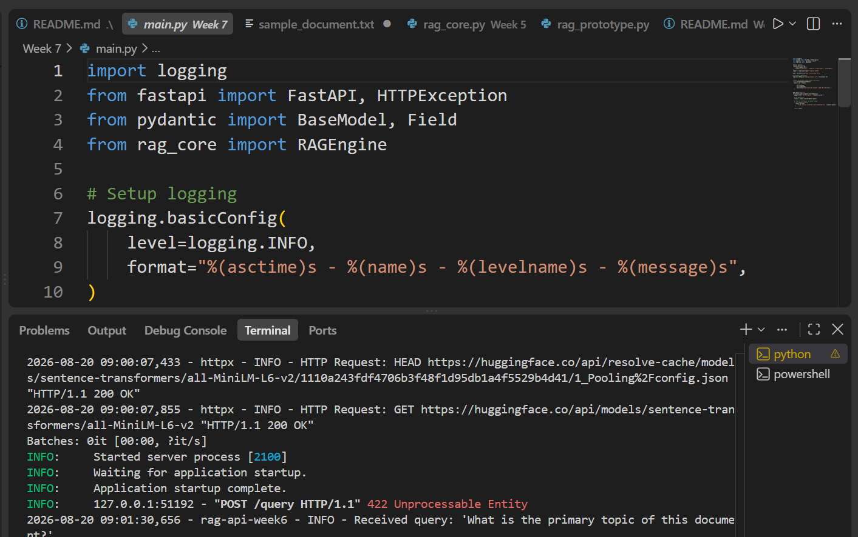
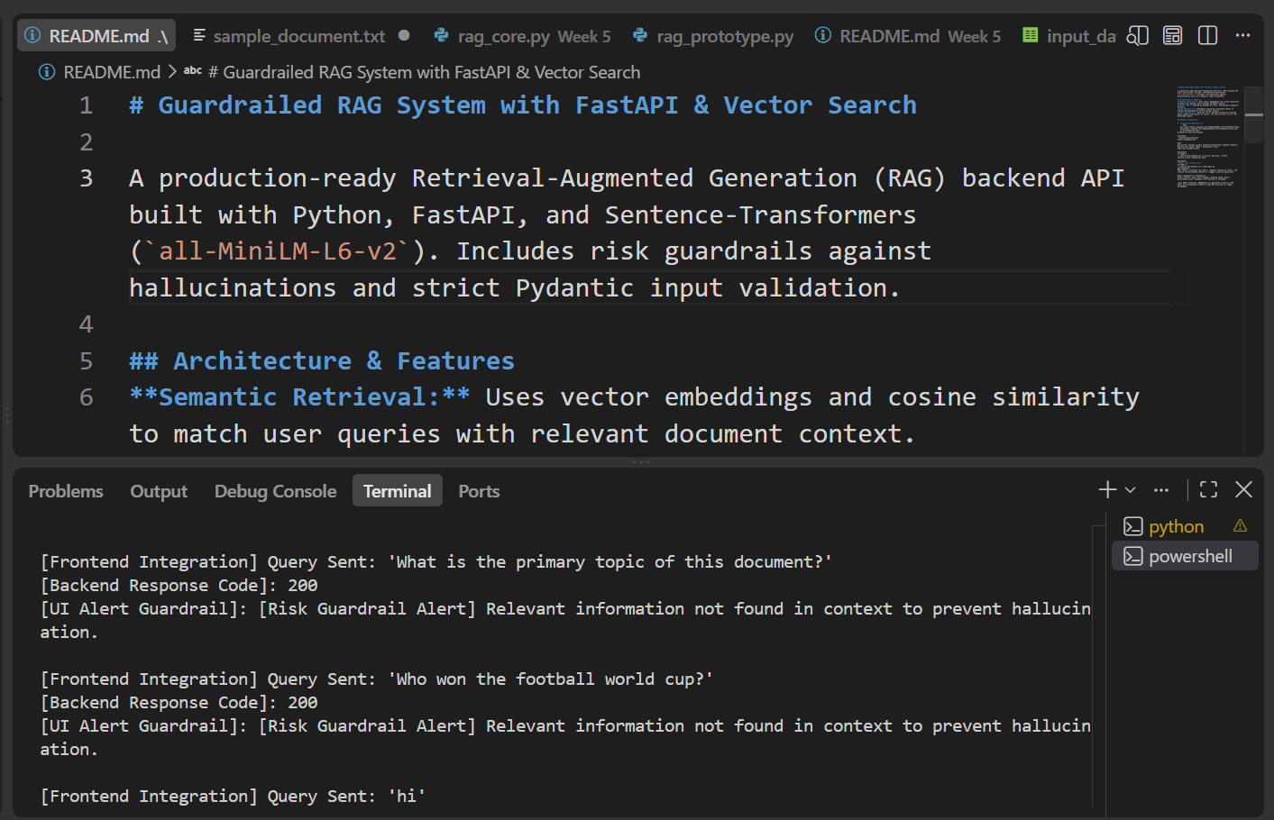
Live Execution Demonstration
Backend Server
Client Terminal Logs
Sarted the FastAPI server locally and watched it handle live, asynchronous requests.
Real queries, vector retrieval, and guardrail alerts shown live through the client script.
7 / 9

Slide 8
Challenges & Debugging
Path Resolution
Score Calibration
Fixed PowerShell directory-pathing and execution-policy issues while testing locally.
Tuned the similarity threshold to 0.35 — strict enough to reject off-topic questions, loose enough to still answer valid ones.
Threshold Calibration
0.35 — chosen threshold
0.0
0.25
0.5
0.75
1.0
← Stricter, more false rejections
Looser, more hallucination risk →
8 / 9

Slide 9
Deliverables & Future Scope
GitHub Artifacts
Future Scope
main.py
Scale the vector database for larger enterprise datasets.
Add multi-turn chat memory to the backend pipeline.
rag_core.py
client_demo.py
test_report.md
README.md
github.com/rehmanamna910-ux/AI-Foundation-Task
9 / 9

